Slide 1

Change Management
International Masters
Spring 2018 program
© Sylvie Appriou

Slide 2
Sessions calendar
Session nb | Date | Time | Contents
1 | Thursday April 19th | 10:00 – 1300 | Introduction
2 | Wednesday April 25th | 10:00 – 1300 | Home work review + class
3 | Wednesday May 16th | 10:00 – 1300 | Home work review + class
4 | Thursday May 31st | 10:00 – 1300 | Home work review + class
5 | Thursday June 7th | 10:00 – 1300 | Home work review + class
6 | Wednesday June 20th | 10:00 – 1300 | Home work review + class
7 | Wednesday June 27th | 10:00 – 13:00 | Home work review + class+ case study preparation
8 | Wednesday July 11th | All day | Case study presentation

Slide 3
Homework : Build your IT strategy and Balanced Scorecard

Slide 4
Class exercise instructions
Based on the exercise material that follows, please prepare, for your imaginary company:
Your IT strategy & objectives
Your metrics balanced scorecards

Slide 5
Your IT strategy template
Strategy | “… …”
Objectives (or goals) | 1. 2. 3. 4.

Slide 6
Your IT Balanced Scorecard
Financial measures | Process measures
Customer measures | Learning and growth measures

Slide 7
Questions to ask yourselves…to define your strategy and objectives
What value does IT provide?
Is IT viewed as an investment and/or cost ?
Does IT enable or slow down growth?
Does IT advance organization learning and development?
Is IT well managed?
Are we getting value for our IT investment?
How does IT influence customer experience?
Does IT favorably influence productivity?
Is IT positioning us for future market demand?
Are organization assets protected?
Are the key business and technology risks managed?
Are proper processes and controls in place?
Are we doing the right thing?
Are we effective?
Can we attract and retain talents?

Slide 8
Questions to ask yourselves…
Do the right thing
Vs.
Do things right
(Effectiveness)
(Efficiency)

Slide 9
Main requirements on IT
Cost management
Technology advisor / innovation
Long term IT strategy
Strong Infrastructure
Responsiveness to change
Flawless operations of business applications (Quality, Availability…)
Risk management
Sound project management
Effective people management
Protect company IT assets
Green IT
…

Slide 10
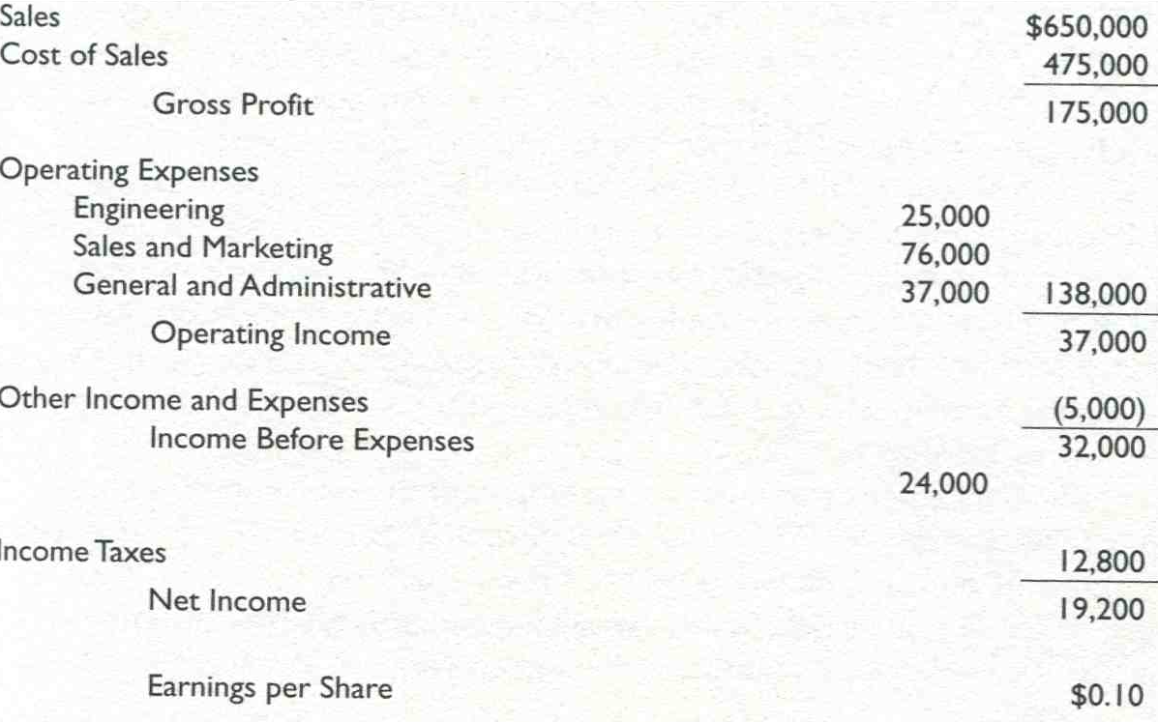
Income Statement (P&L)
IT
Finance
HR

Slide 11
Finance and IT
If you work in the IT department of a 1B$ company then…
Your IT budget is anywhere between 20 m$ and 80 m$ (between 2 and 8% of Revenue)
IT spendings represent 50 % of the company Capital Expenditures
About 20% of budget is for « new things » (projects)
The other 80% is for running and maintaining production apllications or « keeping the lights on »
The lifetime costs of an IT application are, on average, 5 times the initial project investment

Slide 12
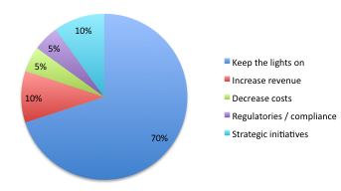
IT activities and budget breakdown
Projects

Slide 13
Categories of IT costs
Travel and Entertainment
IT Overhead
People | Internal Staff Contractors Consultants
HW costs | Servers Network IT equipment
SW costs | Licences - Maintenance In house development
Services | Telecoms Outsourcing Cloud computing

Slide 14
IT strategy examples
Become a single IT organization focused on developing world-class capabilities to serve the distinct needs of our company division
Support the achievement of company strategies and goals
Be the "supplier of choice" for the full range of information services required by our business partners
Operate IT as a full cost recovery, no profit business providing our internal customers with high levels of efficiency and effectiveness
Establish a forward looking enterprise architecture strategy which enables the use of technology as a competitive edge
Become the "employer of choice" for career-oriented IT professionals in the key markets in which we operate

Slide 15
“My OwnIT strategy”, for example
Strategy | Deliver value added for our internal customers Support company growth…
Objectives (or goals) | Fully integrated business and system architecture Flawless IT operations Quality project delivery and realized stated business value Talent management & development Showcase technology to our customers

Slide 16
Your IT metrics template
Financial measures | Process measures
Customer measures | Learning and growth measures

Slide 17
Financial measures
Ideas/examples
IT cost as a % of revenue or number of employees
$ split by activity (Infrastructure, Operational management, Projects, Others….)
Budget vs Actual gap
Project savings as % of investments (ROI)
Cost ratio (%) between IT operations & IT projects
% of budget spent on strategic initiatives
Total cost of ownership for systems
…

Slide 18
Customer measures
Ideas/examples
Customer satisfaction on IT operations or on IT projects
IT project adoption
% of IT projects delivered on time and on budget
Number of customer presentations
Analysis of social networks feedback (Nb of positive, negative comments etc…)
…

Slide 19
Process measures
Ideas/examples
Number of bugs reported or incident ratio
Average time / Maximum time to resolve incidents
Nb of people impacted by an incident
Unplanned system downtime
System response time
Leadtime for Change request implementation
Backlog of change requests
Number of issue cases per employee
Average time for issue case resolution
Project planning effectiveness (on time and budget)
Internal audit measures
Disaster recovery plan in place
ISO certification
Suppliers SLA performance
…

Slide 20
Innovation measures
Ideas/examples
Voluntary/involuntary IT turnover
% permanent employees / contractors
Ratio Management / Total staff
% of promotions
Number of innovation training hours per employee
Number of patents filed
Diversity ratios
IT employee satisfaction results
Implementation of lessons learnt
3 years technology roadmap
% of budget spent on technology watch/research
…

Slide 21
Course schedule and contents
Session 1
Introduction
Setting the scene
Session 2
Strategic alignment
Balance scorecard
Session 3
Understanding change
Resistance to change
Sessions 4 and 5
How to effectively manage change
Change management approach
Session 6 and 7
How to effectively manage change
Change management approach (Ctd)
Monitor operations & report
Recap. & summary
Sessions 8
Final case study preparation

Slide 22
Session contents
Reading debrief
Understanding change
Different types of resistance
How to handle resistance to change
Case study : Sagar change management strategy

Slide 23
Reading debrief

Slide 24
Dealing with Naysayers
Learning
Expect resistance
Stay determined and positive
Assess the “power of influence” your Naysayers have in your organization, either:
Because of their position
Or because they are strong informal influencers
Understand what truly drives their negativity (Meet with them, ask them lots of open questions and listen carefully to their answers)
Convert, purge or quarantine

Slide 25
How to counter resistance to change Isabelle, whom wants ice cream for desert
Learning
Flexibility in negotiation…
People don’t resist change, they resist being changed
Give control and have people own the decisions
Be clear on the outcome you want but give flexibility on how to get there…
…which also drives accountability

Slide 26
Managing resistance
Key points about resistance
In whatever form resistance is a message. It is a way of saying “This is not working for me. I have needs that are not being met.”
Resistance is a sign that the process of change has begun, you cannot resist that which you are not aware of and so something is happening to bring up the resistance
Resistance is also often misconstrued as “people not wanting to change”. On the contrary, people generally are motivated to want to grow and develop and keep improving. Change and the way it is handled can bring up anxiety for people and these results in them adopting seemingly resistive attitudes and behavior in order to keep their anxiety at bay
We all learn and change in different ways, so for someone to stop and ask “Why?” might be a reflection of that person’s need for a model to explain the change or proof that the change will work in practice

Slide 27
Managing resistance
Key points about resistance (Continued)
Overt resistance is healthy, after all if it’s out in the open it’s much easier to work with and it indicates that people are open to being convinced otherwise. Inviting people to voice their concerns and different opinions keeps things overt
Unexpressed resistance is much harder to deal with. If people don’t express their concerns then how can they be addressed?
How resistance is viewed and responded to will make the difference in terms of whether it becomes a block to change or whether it is harnessed as a creative process that allows previously not thought of solutions and steps to emerge

Slide 28
Managing resistance
Why and how people resist? What can be done about it?
Overwhelm
Overwhelm at the Top
Lack of self awareness of the leader and/or facilitator of the change
Beliefs around change
Fear
Ambivalence
Defense mechanisms

Slide 29
Managing resistance
In summary
There are many ways that people can resist change and, at the end of the day, resistance is a message.
Take steps to be proactive, research people’s attitudes and needs so that solutions to potential resistance are available before resistance arises
Even when this has been done people can still resist. Our approach, in this instance, is again to get to the root of the issue that is causing concerns, allow it be expressed and so that the steps for how to proceed can be identified
From this, we can then come up with solutions and strategies that ensure the process of change that takes place, has increased commitment and effectiveness

Slide 30
Resistance to change in organizations
Four reasons why people resist change. They:
Do not understand
Do not have time to engage
Do not have to competencies to be successful in the new world
Do not share the values that drive the change

Slide 31
Resistance to change in organizations
Does the person have the potential to acquire new skills
No
Yes
Invest?
No
Yes
Graceful dignified exit
Invest

Slide 32
Understanding change

Slide 33
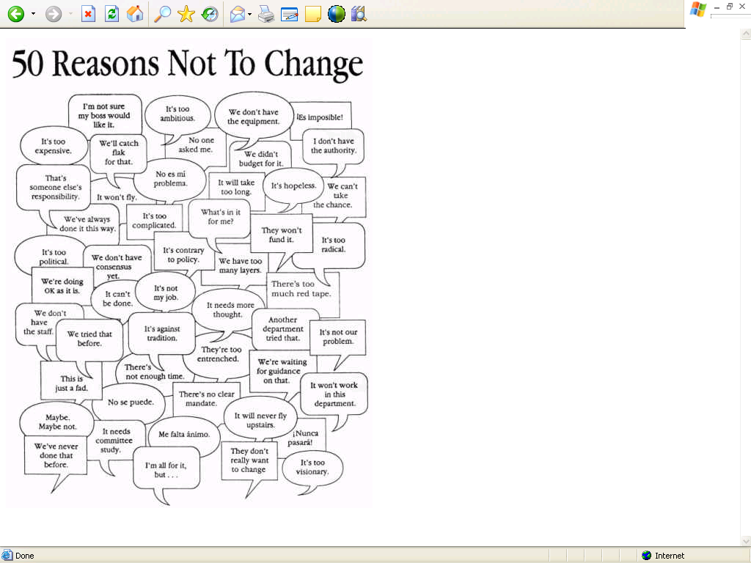
Why change?

Slide 34
How do people resist change? (1/2)
Several forms of resistance: Active vs. Passive
The more obvious forms consist of active resistance, where people will object, or refuse to cooperate with the change
Other, more subtle forms of resistance, however, are more difficult to deal with. Some examples of "resistive symptoms" include:
At a staff meeting everyone agrees to utilize a new procedure, but several weeks later you discover that the procedure has not been implemented
New computers are introduced into the workplace. While all staff insisted that they have their own machines, virtually nobody is using them for the purpose for which they were intended
A change in job responsibilities takes place for an employee. The employee consents to the change by saying: "You're the boss, and if that's what you want...” to appear cooperative. Later the employee only changes a few visible things, but is in fact doing most things the way he was before the change.

Slide 35
How do people resist change? (2/2)
What can happen ?
Ignore the new process
Fail to completely and accurately comprehend
Disagree with the validity of the benefits
Criticize tool or software application
Grant exception
Delay implementation
Etc…

Slide 36
Why do people resist change? (1/3)
Parochial: Self interest
People are concerned with the implications for themselves
Misunderstanding
Poor communication
Low tolerance to change
Feeling of insecurity
Different assessment of situation
Disagreement on the need to change
Comfort with status quo
Disagreement on the advantages/disadvantages of the change

Slide 37
Why do people resist change? (2/3)
Examples
There is no justification for change
My needs are already being met
I don’t like the way they propose to do it
The risks outweigh the benefits
It will now be harder for me to meet my own needs
Organizational barriers to change
Structural inertia
Existing power structures
Resistance from work groups
Failure of previous change initiatives
Company culture

Slide 38
Why do people resist change? (3/3)
Individual barriers to change
Tradition and set ways
Loyalty and existing relationships
Failure to accept need for change
Insecurity
Preference for existing arrangements
Break up of work groups
Different person ambition
Fear of not being to perform in new situation
Fear of:
Loss of power
Loss of skills
Loss of income
Redundancy
The unknown

Slide 39
What NOT to do? (1/3)
Inappropriate change management
Change is often resisted because of the way it is introduced:
Failure to explain the need for change
Failure to provide information
Failure to consult, negotiate and offer support and training
Lack of involvement in the process
Failure to build trust and sense of security
Poor employee relations
People don’t resist change, they resist being changed

Slide 40
What NOT to do? (2/3)
A few of the ways you can cause people to resist the change
Resist the resistance, fight back
Do not use your sponsors
Try to do everything yourself
Allow sponsors to be non-committal about the change
Use threats and aggressive language
Avoid talking to individual people
Avoid listening to people
Do not visit the various teams affected
Spend more time with your allies (and avoiding the troublemakers)
Ignore those who resist. Keep your fingers crossed they will give up
Tell people about your plans and then ignore the plans
Give lots of rational reasons why people should do as you say

Slide 41
What NOT to do? (3/3)
A few of the ways you can cause people to resist the change (Continued)
Dive into the details before they have bought the big picture
Do not test that people have understood what you have said
Lose faith yourself in the change
Be vague about what the change will be
Avoid being the messenger of bad news
Collude with the other person
Produce non-specific plans
Expect people to instantly understand what took you 3 weeks to figure out
Publicly and aggressively punish those who object
Shout down anyone who disagrees
Do not change reward systems to align with the change
Make “an exception” for talented people who resist

Slide 42
Dealing with resistance (1/3)
Facilitation
The best approach to creating change is to work with them, helping them achieve goals that somehow also reach to the goals of the change project
When you work with people, they will be happier to work with you
This is a good practice when people want to collaborate but are struggling to adjust to the situation and achieve the goals of change
Education
When people are not really bought into the rationale for the change, they may well come around once they realize why the change is needed and what is needed of them
In particular, if new skills are required, you can provide these via a focused course of education

Slide 43
Dealing with resistance (2/3)
Involvement
When people are not involved physically or intellectually, they are unlikely to be involved emotionally either
One of the best methods of getting people bought in is to get them involved
When their hands are dirty, they realize that dirt is not so bad, after all
They also need to justify their involvement to themselves and so persuade themselves that is the right thing to do
Negotiation
When the other person cannot easily be persuaded, then you may need to give in order to get
Sit them down and ask what they are seeking. Find out what they want and what they will never accept.
Work out a mutually agreeable solution that works just for them and just for you

Slide 44
Dealing with resistance (3/3)
Manipulation
Manipulation means controlling a person's environment such that they are shaped by what is around them
It can be a tempting solution, but is morally questionable and, if they sense what you are doing, will lead to a very dangerous backlash
Only consider this when change is necessary in the short term and all other avenues have been explored
Coercion
Even more extreme than subtle manipulation is overt coercion
This is where you sit them down and make overt threats, for example that if they do not comply that they will lose their jobs, perhaps in a humiliating and public sacking
This should only be used when speed is of the essence or when the other person themselves has taken to public and damaging actions

Slide 45
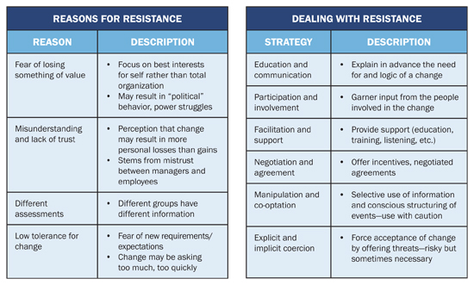
Tactics for dealing with resistance to change

Slide 46
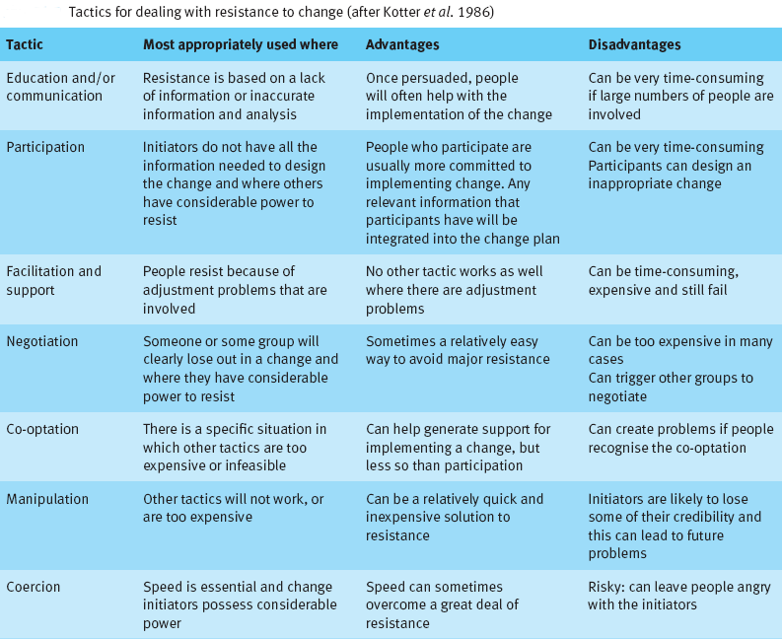
Tactics for dealing with resistance to change

Slide 47
Strong and weak commitment (1/2)
Commitment varies in depth
When you think you have commitment, it may just be shallow
It is important to understand the real commitment you are getting, particularly from key sponsors and major groups of people
Deep commitment
A good understanding of the logic and other reasons
Alignment of the commitment with personal beliefs, values and motivations
Strong emotional buy-in to required actions
Quite likely a personal attachment to the person doing the persuading
A lasting and robust commitment that withstands counter-arguments
Little questioning or doubt about what needs doing
Timely actions and persistence in the face of adversity

Slide 48
Strong and weak commitment (2/2)
Shallow commitment
A significant danger in change is a shallow commitment that hides doubt or and actual resistance to change
Shallow commitment is characterized by
Possibly a limited understanding of the logic of the argument
Misalignment with one or more of beliefs, values and motivations
Limited trust or liking of the person doing the persuading
Low emotional buy-in
Wait-and-see, detached attitude. Watching what others do
Minimal substantive commitment
Internal justification for limited actions
Shallow commitment often appears when people understand your argument but are not really bought into the change
For example because they are happy with existing arrangements or are fearful of making a commitment to something they doubt sustainably might work in practice

Slide 49
Change opportunity
Why change should be welcome ?
Change can produce positive benefits for the individual
Opportunities for personal change and development
Provides a new challenge
Reduces the boredom of work
Opportunity to participate and influence the outcome

Slide 50
Principles for successful change
Key take away
Different people react differently to change
Everyone has fundamental needs that need to be met
Change often involves a loss and people go through the loss curve
Expectations need to be managed realistically
Fears have to be dealt with
Re: “How to counter resistance to change article”
Define outcome
Suggest a path to achieve it
Allow people to reject your path as long as they choose an alternate route to the same destination

Slide 51
Personality types

Slide 52
Personality types
Three modern theories closely associated with Jung's personality types
Keirsey Temperament Sorter
Myers-Briggs Type Indicator
Socionics
Other theories
16 Personality Factors
Big Five personality traits
DISC assessment
Enneagram of Personality
Eysenck's three factor model
Eysenck Personality Questionnaire
Five Temperaments
Four Temperaments
Fundamental Interpersonal Relations Orientation
HEXACO model of personality structure
Humorism
Personal Style Indicator
Type A and Type B personality theory
Humanistic type
Holland Codes

Slide 53
David Keirsey's interpretation of the four temperaments
Artisan
says what is,
does what works
Rationalist
says what's possible,
does what works
Guardian
says what is,
does what's right
Idealist
says what's possible,
does what's right

Slide 54
Thank you!
See you next time

